Slide 1

ECE-3003
Microcontroller and its Application
EVM-Electronic Voting Machine

Slide 2

Group Members
Sanskar Biswal 16BEC0403
Nitya Bhargava 16BEC0792

Slide 3
Objective
Electronic voting machine has now replaced the traditional mechanism of voting due to several advantages like security, automatic counting etc. This project presents a way to develop an electronic voting machine which displays the count of votes on a 16x2 LCD interface. A user can get his/her vote register through a set of switches (one for each candidate). After every cast of vote, the subsequent count can be seen on LCD. The circuit uses 8051 microcontroller and the code for the project has been written in C.

Slide 4
Introduction
The project is designed for eight contestants. Voters can poll their vote to any one of the contestant. In this project, one port is dedicated for 8 push-button switches for eight contestants, and a master switch for polling officer. A simple yet powerful program is written in assembly language and is burnt onto the microcontroller to accept votes and to keep counting the total votes polled. A Polling-officer switch (master) is provided to avoid multiple polling by a single voter. Every voter gets approval from the polling officer. If the polling officer issues approval with his control switch, then only the voter can poll his vote.

Slide 5
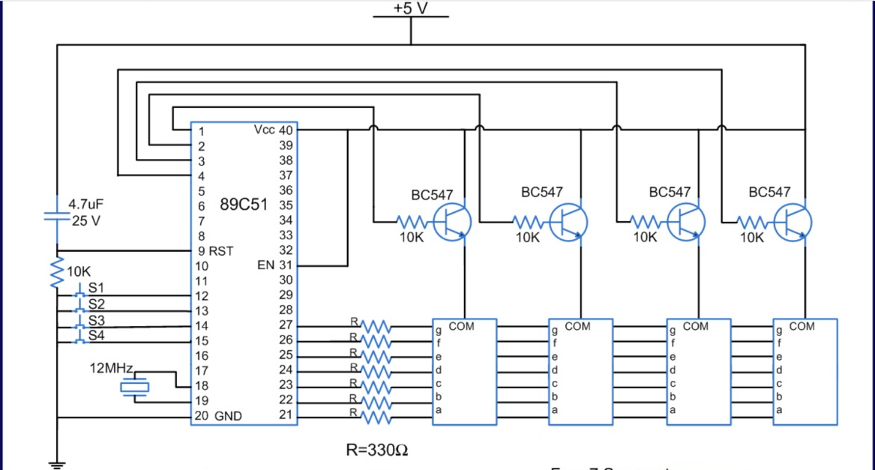
Block Diagram

Slide 6
Hardware Requirements
8051 series Microcontroller
Push Buttons
Transistors
Transformer
Voltage Regulator
LED
Resistors
Capacitor
EEPROM
Buzzer

Slide 7
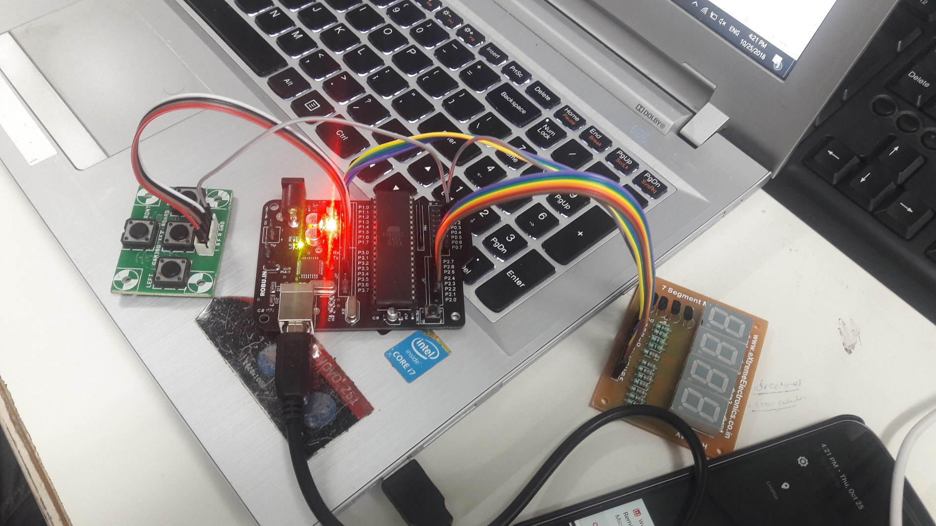
Setup

Slide 8
Applications
Fast track voting which could be used in small scale elections, like resident welfare association, “panchayat” level election and other society level elections.
It could also be used to conduct opinion polls during annual share holders meeting.
It could also be used to conduct general assembly elections in school and colleges to introduce idea about democracy.

Slide 9
References
www.keil.com/docs/datashts/atmel/8051
https://www.tutorialspoint.com/embedded_systems/es_microcontroller.htm
www.google.com

